Slide 1
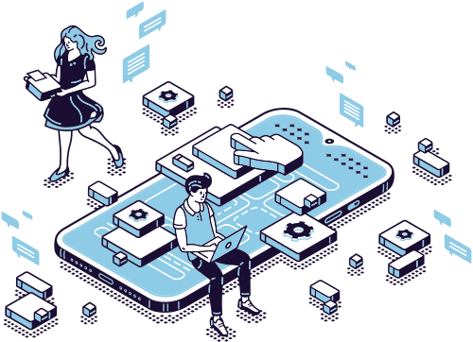
Mobile programing and Internet Programing
CEF 444
DR Valery

Slide 2
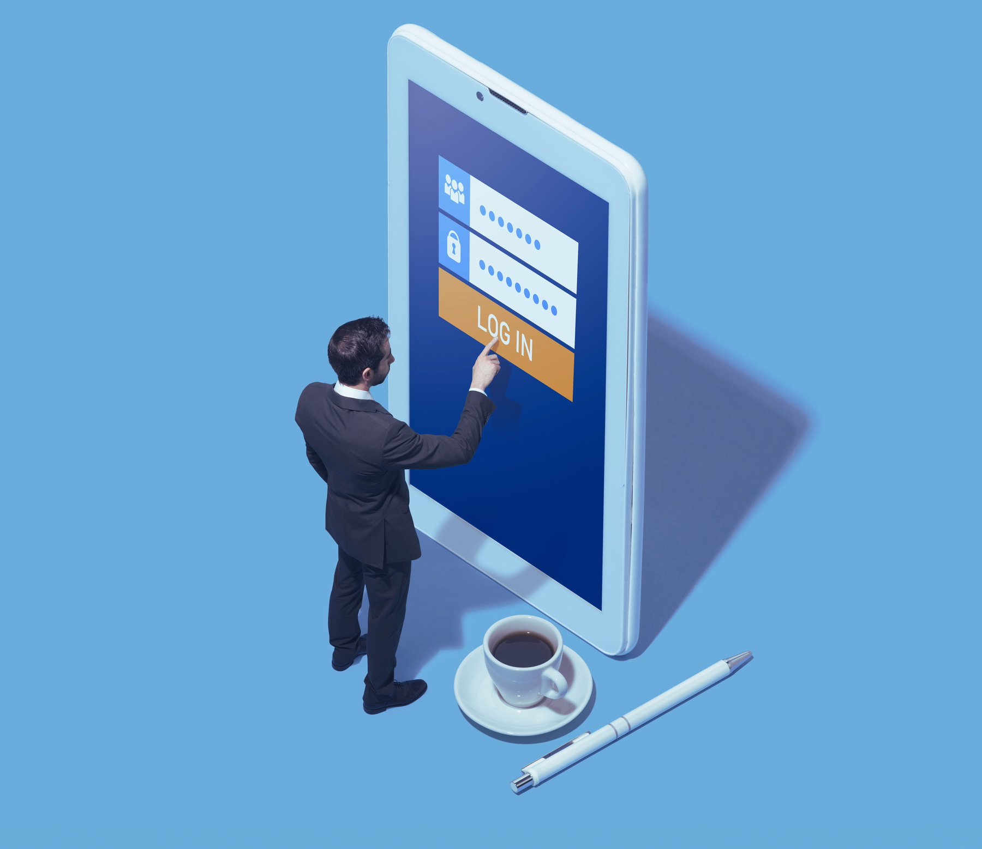

#inovation
table of content
Usecase
Sequence DIagram
class Diagram
sequence 1
Sequence Diagrams
sequence 2
Activity Diagram
sequence 3
sequence 4

Slide 3
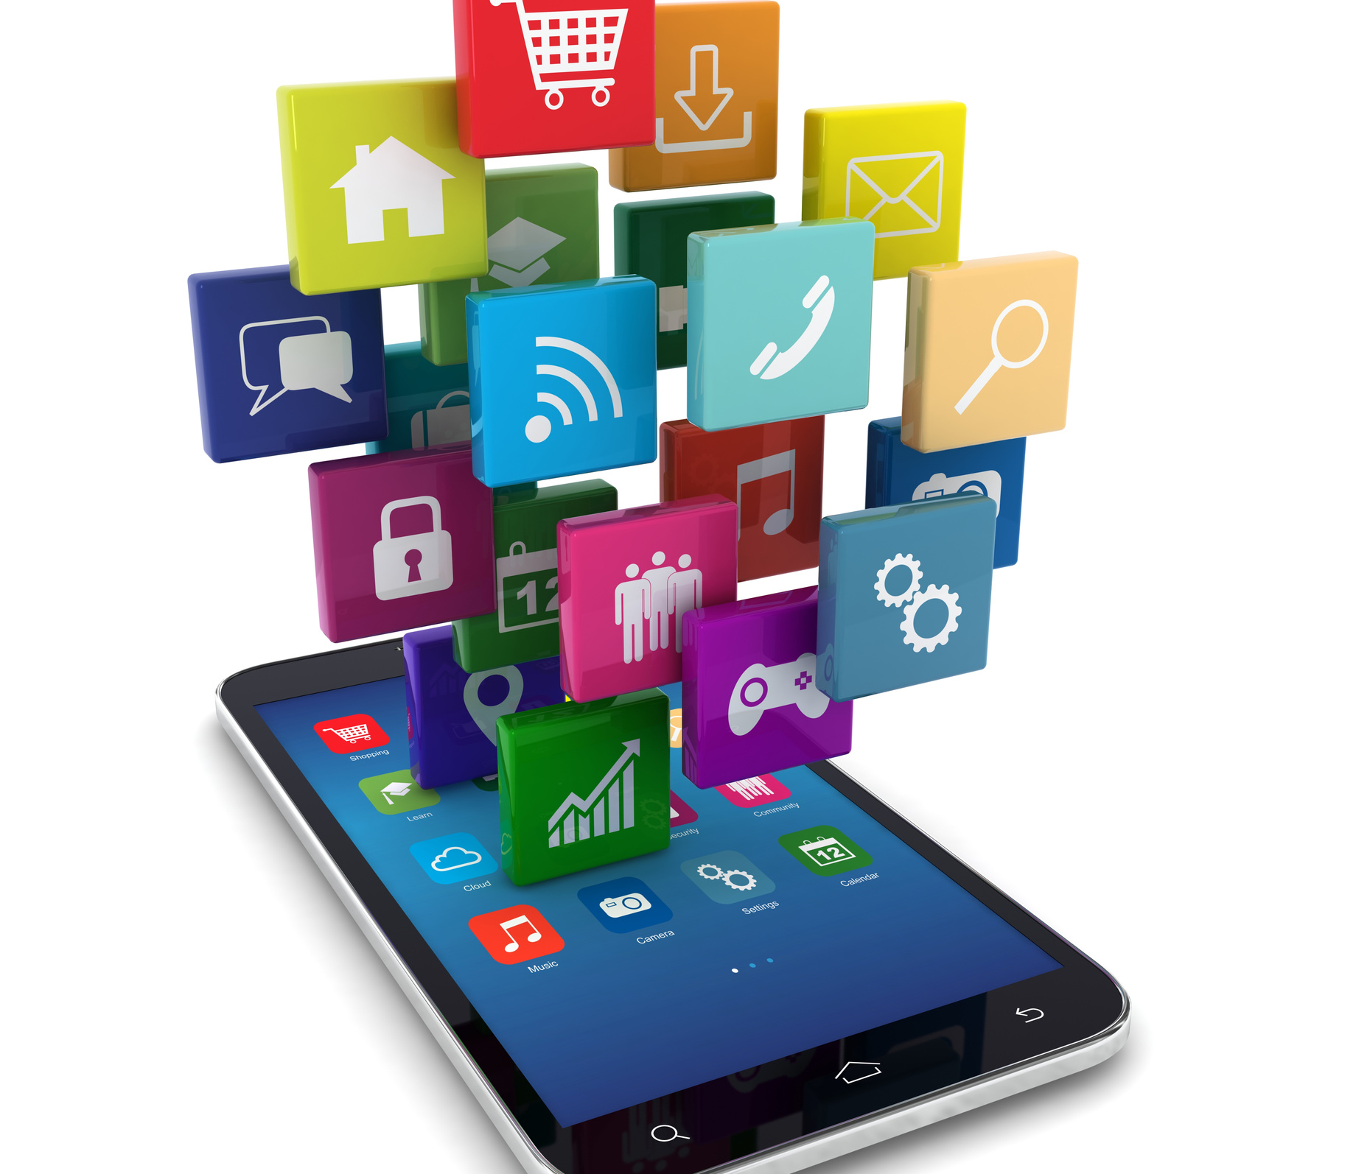

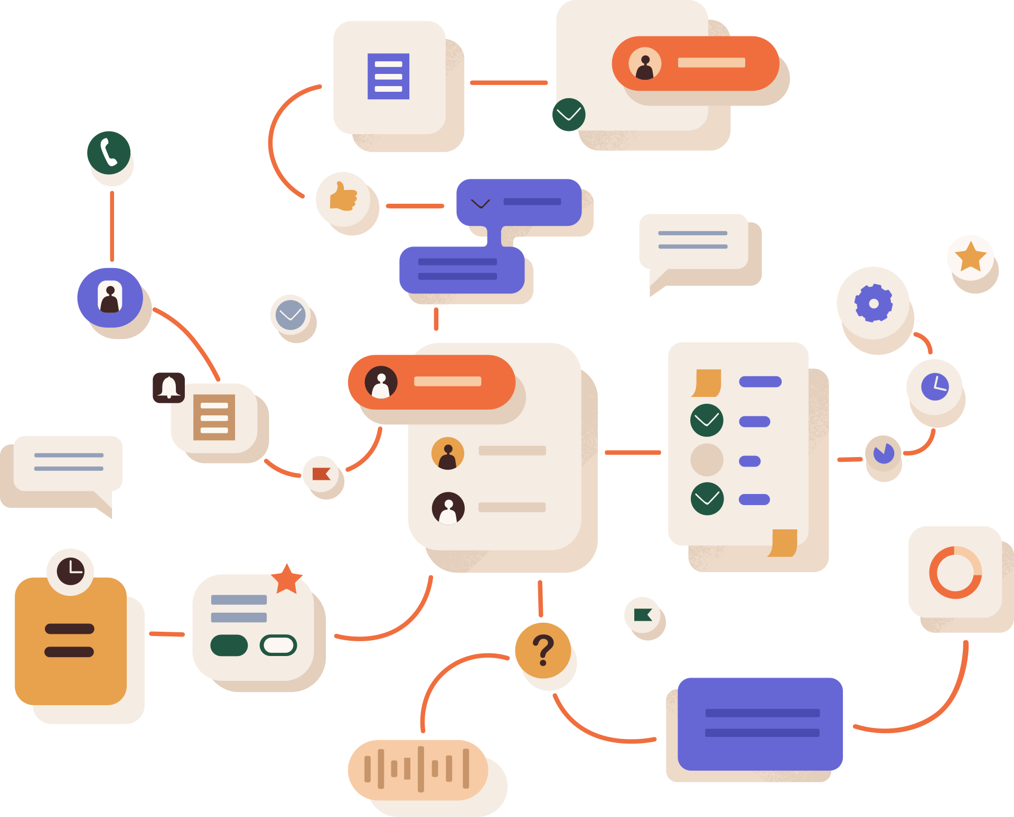





System Actors
#inovation
system
passengers
Transportation
agencies

Slide 4

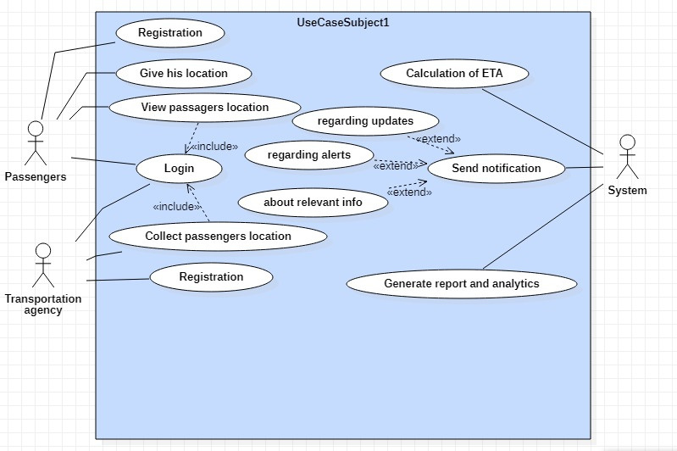
Usecase Diagram
#inovation

Slide 5


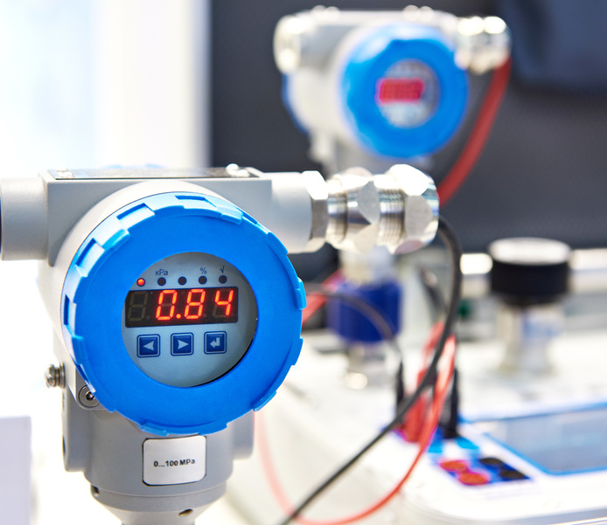
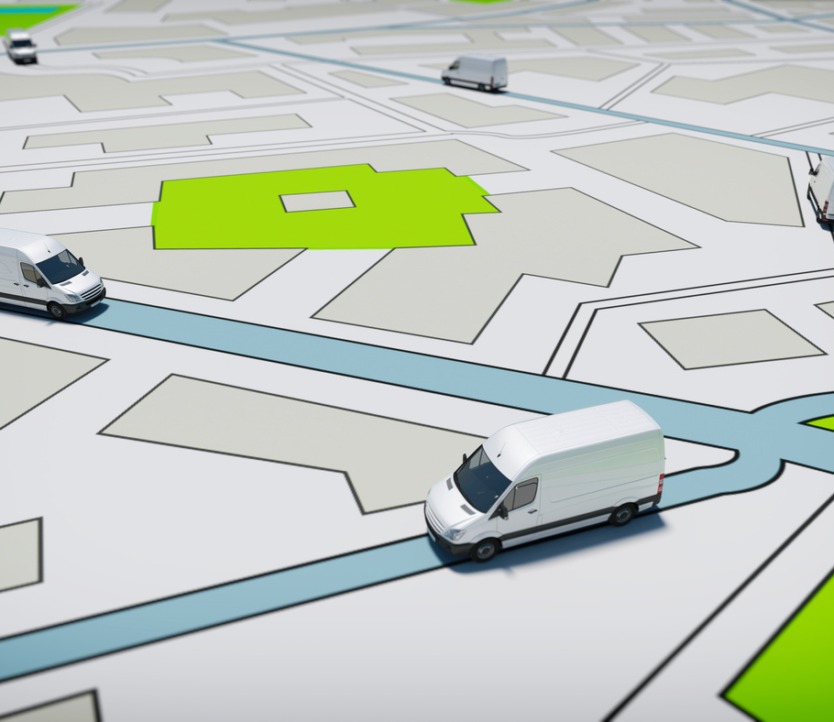

system classes
#inovation -2
passengers
location
Sensors
tracking system
transportation agencies

Slide 6
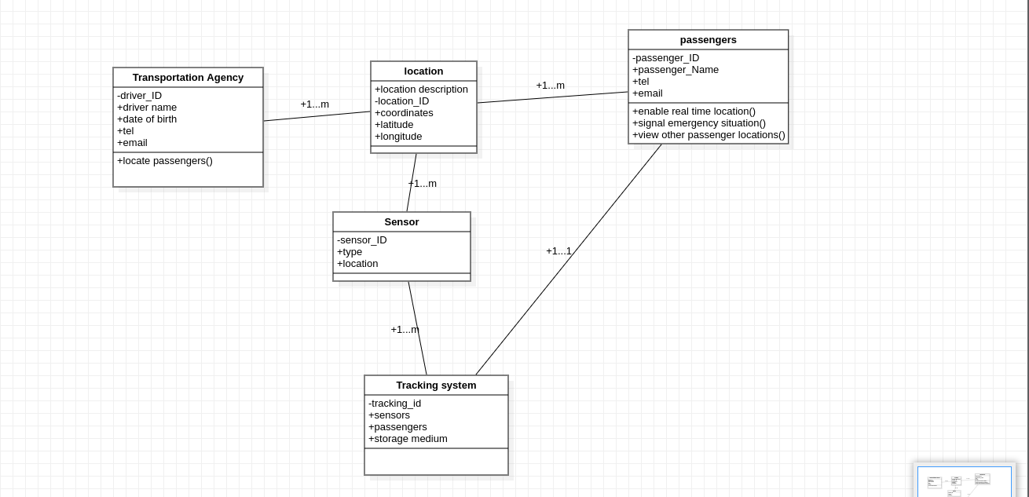

CLASS DIAGRAM

Slide 7





#inovation-2
use cases and their sequence Diagram
v. p .lovation
Marketing
Strategy

Slide 8
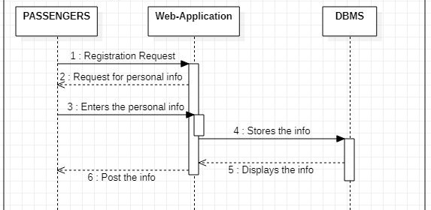

#inovation-2
SEQUENCE 1: REGISTRATION

Slide 9
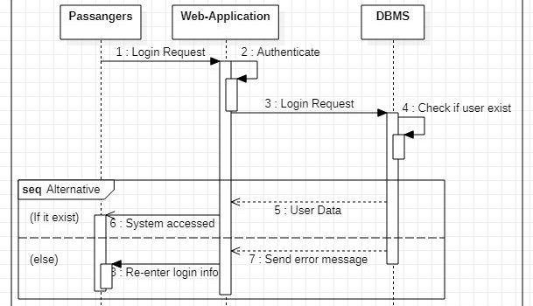
SEQUENCE 2: LOGIN
#inovation-2

Slide 10
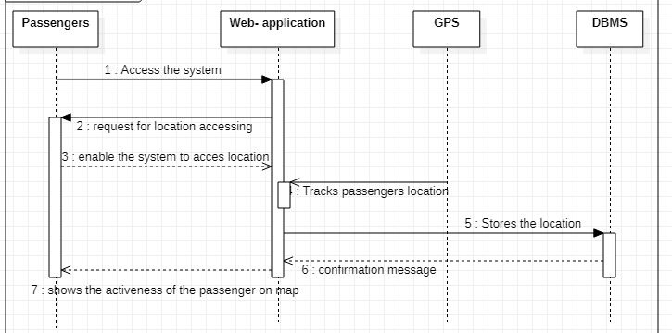
SEQUENCE 3: PASSENGER GIVE LOCATION

Slide 11
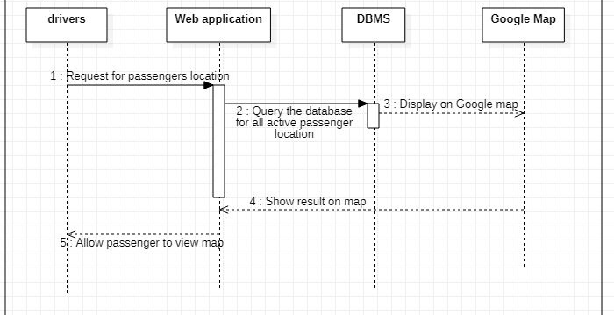
SEQUENCE 4: VIEW PASSENGER LOCATION

Slide 12
activity diagram flow steps
Initialize Tracking System
Connect Sensors
Begin Tracking
Detect Passenger Location
Update Passenger Location
Check for Passenger Movement
Generate Alert if Passenger Moves from Expected Location
Store Passenger Location Data
Provide Real-Time Location Data to User Interface
Generate Reports on Passenger Movement
Stop Tracking
End

Slide 13
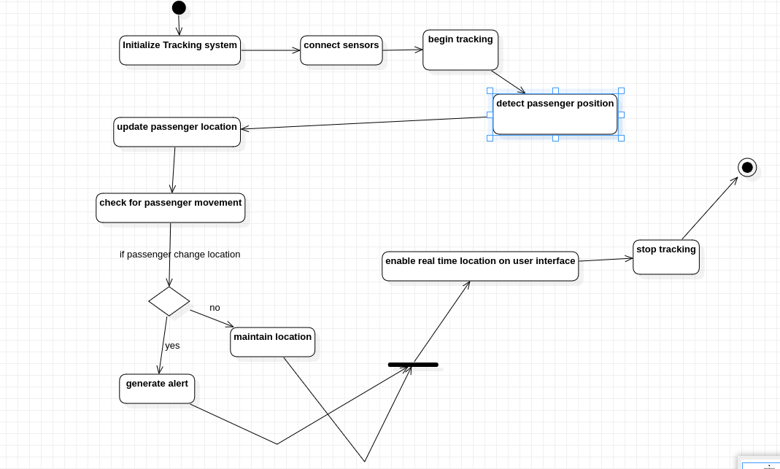
Activity Diagram
#inovation -2

Slide 14

#inovation-2
thank you

